Slide 1
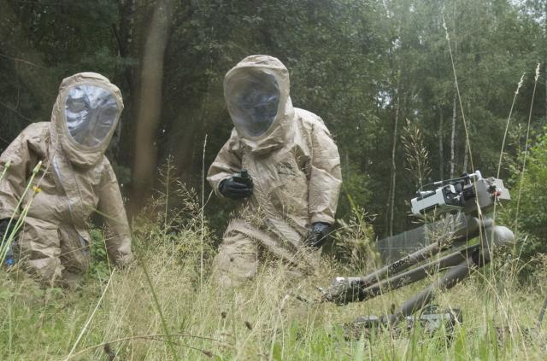
ARIBO-IH
Login:
Password:
Submit

Slide 2
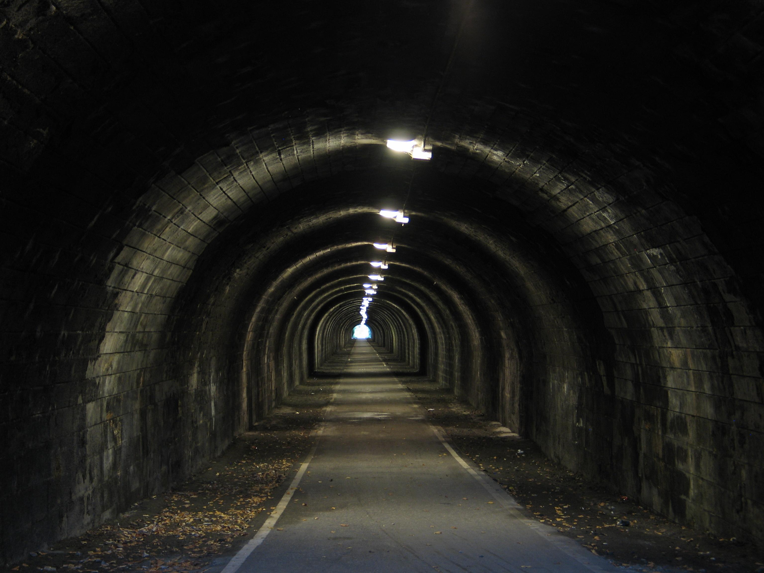
Aribo-IH
Distance/Router
Status Log □
Status Log □
CO
Time
1100 – Green
1200 – Green
1238 – Red □
└ Location/Chemical
H2
CH4
LPG
Alert!
Auto
Manual
Track
Camera

Slide 3
Aribo-IH
Distance/Router
Status Log □
Status Log □
CO
Time
1100 – Green
1200 – Green
1238 – Red □
└ Location/Chemical
H2
CH4
LPG
Alert!
Auto
Manual
Camera Movement
Track
Y-Axis
X-Axis
Camera

Slide 4
Aribo-IH
Distance/Router
Status Log □
Status Log □
CO
Time
1100 – Green
1200 – Green
1238 – Red □
└ Location/Chemical
H2
CH4
LPG
Alert!
Auto
Manual

Slide 5
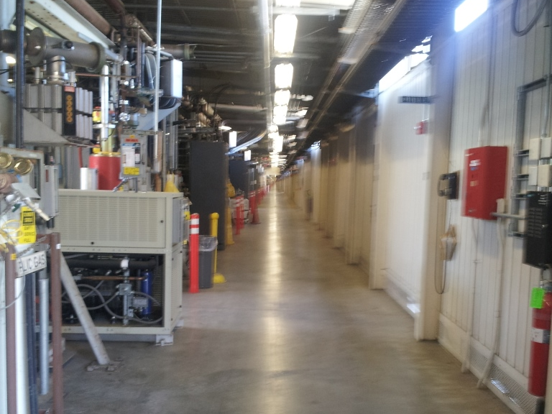
Aribo-IH
Distance/Router
Status Log □
Status Log □
CO
Time
1100 – Green
1200 – Green
1238 – Red □
└ Location/Chemical
H2
CH4
LPG
Alert!
Auto
Manual
Camera Movement
Track
Y-Axis
X-Axis
Camera

